Slide 1

Crop Yield Prediction using Machine Learning
TEAM MEMBERS :
MANASWI – 2520030411
MANISHA-2520030054
GUIDE:
DR. Nirmalajyothi Narisetty

Slide 2
Introduction
Agriculture plays a vital role in food production and economic development.
Crop yield depends on factors such as rainfall, temperature, soil characteristics, crop type, and cultivated area.
Traditional methods of yield estimation may not capture complex relationships between these factors.
Machine Learning (ML) can analyze historical agricultural data and identify patterns for accurate yield prediction.
This project uses Random Forest, XGBoost, and Support Vector Regression (SVR) to predict crop yield.
The predicted results can support better agricultural planning, resource management, and decision-making.

Slide 3
Problem Statement
Traditional yield estimation relies mainly on historical records and manual methods.
These methods may be less effective when multiple environmental and agricultural factors interact.
Accurate yield prediction is important for resource planning and agricultural decision-making.
Therefore, an ML-based system is developed to predict crop yield from relevant agricultural features.

Slide 4
Objectives
Collect and prepare a suitable agricultural dataset.
Perform data preprocessing and exploratory data analysis.
Select relevant features for crop-yield prediction.
Develop regression models using Random Forest, XGBoost, and SVR.
Evaluate models using MAE, MSE, RMSE, and R².
Compare model performance and identify the suitable model for prediction.

Slide 5
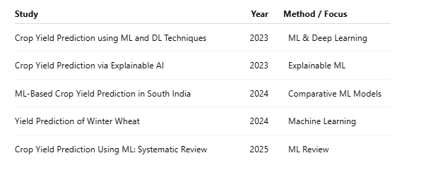
Literature Survey
Research Gap:
Existing studies use different datasets, crops, features, and ML techniques. This project focuses on comparing Random Forest, XGBoost, and SVR using a common agricultural dataset.

Slide 6
Proposed System
Collect agricultural dataset.
Clean and preprocess the data.
Handle missing and categorical values.
Perform EDA and select relevant features.
Train Random Forest, XGBoost, and SVR models.
Tune model parameters.
Evaluate and compare model performance.
Predict crop yield using the selected model.

Slide 7
System Flow Diagram
Flow:
Dataset Collection
↓
Data Inspection
↓
Data Cleaning & Preprocessing
↓
Feature Selection
↓
Train-Test Split
↓
Model Training
↓
Random Forest | XGBoost | SVR
↓
Hyperparameter Tuning
↓
Yield Prediction
↓
Model Evaluation
↓
Final Prediction

Slide 8
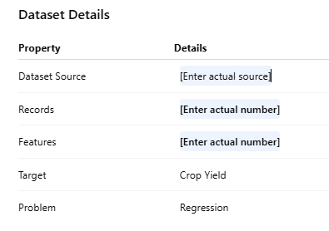
Dataset Description
Dataset Type: Indian Agricultural Dataset
Problem Type: Supervised Regression
Target Variable: Crop Yield
Main Features: Crop Type, Area, Rainfall, Temperature, Soil, Irrigation
Feature Types: Numerical and Categorical

Slide 9
Data Preprocessing & EDA
Data Preprocessing
Data inspection
Duplicate removal
Missing-value handling
Invalid-value and outlier analysis
Categorical encoding
Numerical scaling for SVR
Feature selection
Train-test splitting
EDA
Crop-wise distribution
Yield distribution
Rainfall vs. yield
Temperature vs. yield
Correlation heatmap
Outlier analysis

Slide 10
Model Building
1. Random Forest
Ensemble of multiple decision trees.
Captures nonlinear relationships.
Provides feature-importance information.
2. XGBoost
Gradient-boosting-based algorithm.
Builds trees sequentially to reduce prediction errors.
Effective for structured/tabular data.
3. SVR
Regression algorithm based on Support Vector Machines.
Uses a suitable kernel to model relationships.
Requires feature scaling for effective performance

Slide 11
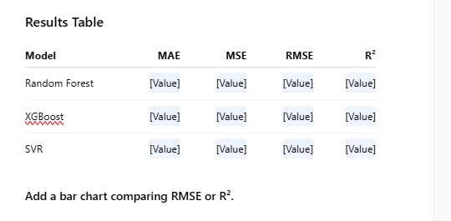
Model Evaluation & Results tips & takeaways
Evaluation Metrics
MAE: Measures average absolute prediction error.
MSE: Measures average squared error.
RMSE: Measures prediction error in the target's units.
R²: Measures how well the model explains variation in crop yield.

Slide 12
Conclusion & Future Scope
Conclusion
The project applies Machine Learning to crop-yield prediction.
Agricultural and environmental features are preprocessed and analyzed.
Random Forest, XGBoost, and SVR are trained as regression models.
Models are evaluated using MAE, MSE, RMSE, and R².
The model results can support data-driven agricultural planning.
Future Scope
Use larger and more diverse datasets.
Include satellite and weather data.
Explore advanced ensemble and deep-learning models.
Apply Explainable AI techniques.
Develop a web/mobile application for real-time prediction.

Slide 13
References
References
Crop Yield Prediction using Machine Learning and Deep Learning Techniques, 2023.
DOI: 10.1016/j.procs.2023.01.023
Crop Yield Prediction via Explainable AI and Interpretable Machine Learning, 2023.
DOI: 10.1016/j.agrformet.2023.109458
Machine Learning-Based Crop Yield Prediction in South India, 2024.
DOI: 10.3390/computers13060137
Yield Prediction of Winter Wheat at Different Growth Stages Based on Machine Learning, 2024.
DOI: 10.3390/agronomy14081834
Crop Yield Prediction Using Machine Learning: An Extensive and Systematic Literature Review, 2025.
DOI: 10.1016/j.atech.2024.100718

Slide 14
THANK YOU

